Slide 1
PROJECT DOOR STEP
Singapore
Office Visit- March 1-3, 2000
Report Issued- March ___, 2000
Confidential

Slide 2
Project Doorstep-Singapore
Review Highlights
Project Objective:
We performed an on-site review of processes, procedures and controls that support the trading and origination business activities within the Singapore office. Our procedures included interviews with key commercial and accounting personnel. We also performed a test of commodity transactions from deal execution through settlement.
Team Members: Office Personnel Interviewed:
Bill Bradford - RAC John Chismar - Office Manager
Rudi Zipter - RAC John Thomas - Director - Crude Trading
Scott Earnest - Risk Management Eng Wang Moi - Director Products Trading
Tom Bauer - AA Hang Wong - Director Products Trading
Jim Brown - AA Russell Aeria - Manager - Petrochemicals
John Vickers - AA Lim Tiong Hock - Director Accounting
Matthias Lee - Legal Counsel
Carol Chew - Risk Management
Seok Wan Soh - Logistics
Eric Tan - Logistics

Slide 3
Project Doorstep-Singapore
Current Portfolio
Liquids
300+ deals, mostly financial.
Physical deals typically no greater than 3 month terms.
Trade exchange contracts via Nymex and IPE.
Largest physical position is First Gas Holdings (FGH) contract.
* DEAL TEST- Tested 7 commodity deals (3 physical)
Rudi
FGH
3 test cargoes have been delivered; no deliveries under contract.
Term of deal is 2 1/2 years for 900,000 bbls/month.
Contract extension signed in event natural gas is not available to fuel plant.

Slide 4
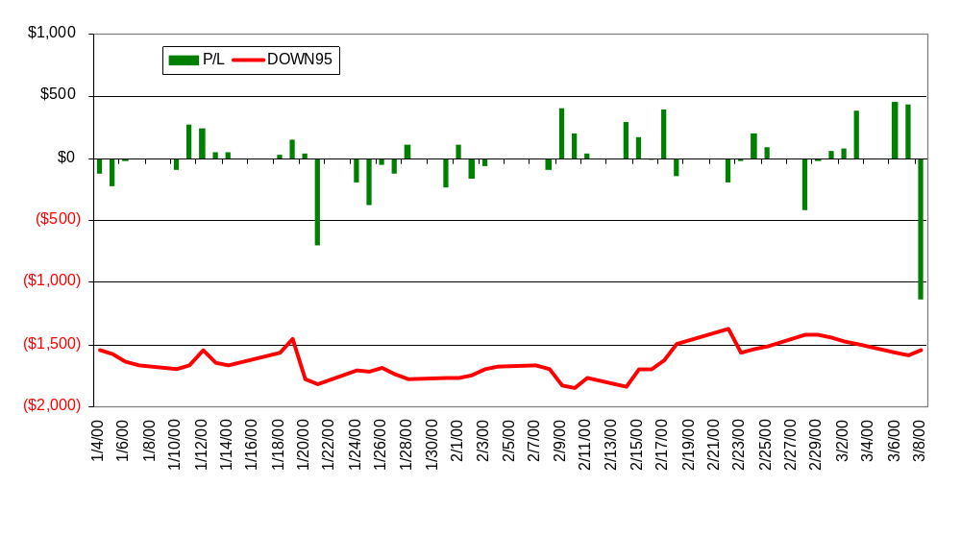
Singapore V@R vs. P/L
Project Doorstep-Singapore
Current Portfolio
RoV@R = -2% SHARPE RATIO = -12.2%

Slide 5
Project Doorstep - Singapore Observations
EFFECTIVE CONTROLS
Knowledgeable back-office personnel (risk management, logistics and accounting)
Financial transactions papered in London
Transactions captured on existing trading systems (TAGG and Right Angle)
Financial settlements approved and processed by London operations
Cash settlements forecast provided weekly to London
Deal documentation complete and easily accessible

Slide 6
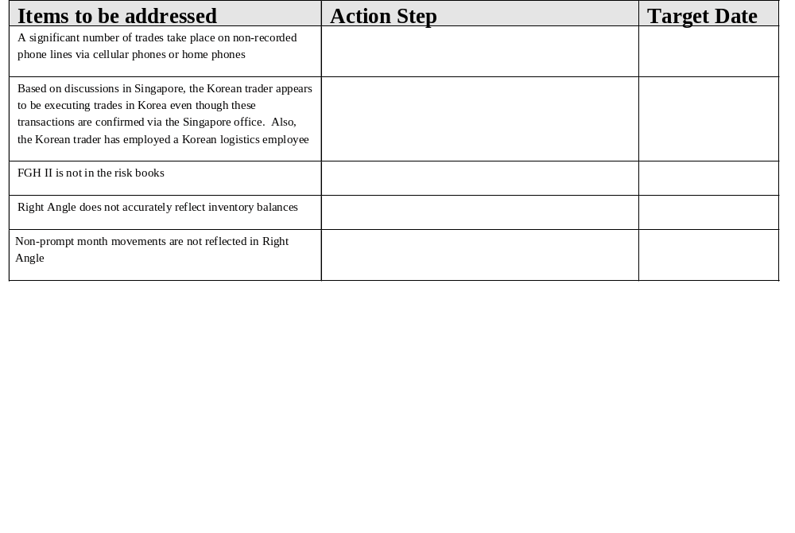
Project Doorstep - Singapore Observations

Slide 7
Project Doorstep - Singapore Observations
OUTLOOK
Review the extension of credit to Vietnam, Malaysia and other government based counterparties
Broadband expansion in region
Both Singapore and Sydney believe that with the addition of the Japan office, an Asia/Pacific back office hub (at one of the 3 locations) would be beneficial
Logistics on FGH could be key success factor

Slide 8
Project Doorstep - Singapore
Office Analysis Framework
Market Structure
Primarily financial market market environment.
Sophisticated trading environment
Strategy
Enron is relatively new to the market is is trying to make up ground compared to competitors.
Continuing focus on global nature of products and take advantage of market knowledge based in Houston and London.
Management
Commercial personnel report to product trading heads located in London or Houston. “Office Head” not responsible for all trading activity out of or through (Korea) office.
Commercial and operations groups primarily locals, few key positions held by seasoned Enron personnel.
Several energy operations support functions performed in London, rapid portfolio expansion may necessitate local operations.
Counterparties
JAron, First Gas Power, Morgan, Commonwealth Bank, BP, Citibank, Vitol, StatOil, Phibro, KOCH.
Competitors
Shell, Chevron, Jaron & Morgan….

Slide 9
Project Doorstep - Singapore
Office Analysis Framework
Business Processes
Back-office coordination between London and Singapore:
Deal Documentation for Financial deals performed in London.
All settlements performed and approved by London personnel.
Position reports prepared for distribution by Risk Management daily.
Credit approval coordinated with London.
Information
Positions for liquids distributed to trading management and traders daily.
Risk Profile (positions and YTD p&l) delivered to senior management daily via DPR.
Weekly cash forecast position communicated to London weekly.
Systems
Liquids transactions utilize established Houston/London trading systems (i.e., ERMS, Right Angle)
Financial Liquidation handled in London via Sift.

